Slide 1
Let’s start with previous lectures recap
Lecture 5 was about: NoSQL, incl. MongoDB, Elastic Search, TigerGraph, and CosmosDB
Lecture 6 was about:
Hadoop MapReduce and HDFS
Created by Freepik

Slide 2
Data Science, Data Engineering, Data Management... Data Art?
Big Data in 30 hours
Lecture 7: Apache Spark
Cracow University of Technology (Politechnika Krakowska)
Faculty of Physics, Mathematics and Computer Science
Original course title:
Methods and tools for big data analysis, code WFMiI I oIIS D2 17/18
Graduate Master’s degree studies, 2nd year
2018/2019
Venue: Room F020, ul. Podchorążych 1, Kraków (budynek wydz. Fiz Mat i Inf)
Time: Every Wed, 9:00, Oct 2018 through end Jan 2019
Copyright and contact: Pawel Plaszczak, pp@altanova.pl
(except third party content – where explicitly noted)

Slide 3
Hadoop MapReduce issues
Only some type of computations supported
Not easy to program
Missing abstractions for advanced workflows
Streamed data, interactive data, DAG workflows, heterogeneous tasks - difficult

Slide 4
Apache Spark: the concept
Written in Scala
Scala code compiles into JVM bytecode
Focused on in-memory processing
In memory, 100x faster than MapReduce
10x faster on disk
Allows for a wide range of workflows. More flexible and easy in programming
Leverages a lot of Hadoop infrastructure: Mesos, YARN, HDFS

Slide 5
Apache Spark
History
UC Berkeley's AMPLab in 2009
Donated to Apache 2013. Now among the most vibrant Apache projects in version 2.4
Industrial ecosystem
Apache Software Foundation: maintains the code base
Databricks: provides commercial support and more (Unified Analytics Platform)
Hortonworks: employs Hadoop creators and provides services and software around Hadoop; HDP (NASDAQ)
Cloudera: originally a Hadoop disribution, incorporated 2008, now trades as CLDR at NYSE since 2017

Slide 6
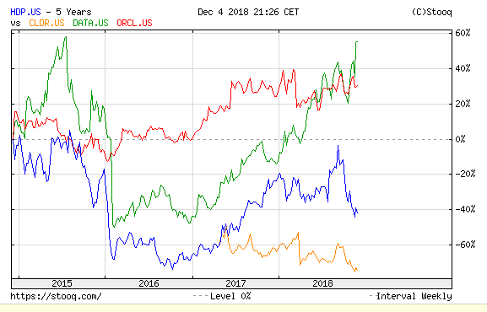
source: sooq.com

Slide 7
Apache Spark: key terms
DAG, direct acyclic graph
RDD, resilient data set
SparkContext
Mesos, YARN
Workers, Executors

Slide 8
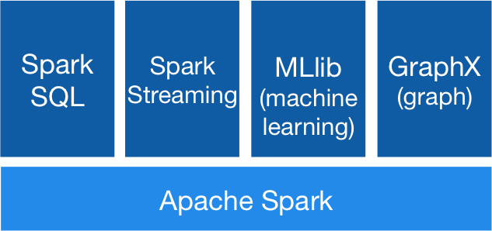
components
source: apache.org

Slide 9
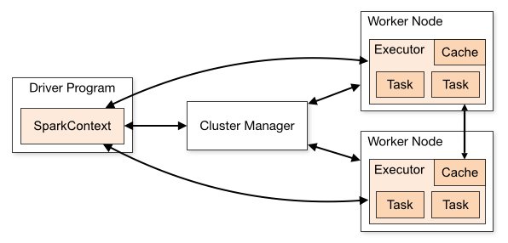
Apache Spark: architecture
source: apache.org

Slide 10
Cluster managers
The system currently supports three cluster managers:
Standalone – a simple cluster manager included with Spark that makes it easy to set up a cluster.
Apache Mesos – a general cluster manager that can also run Hadoop MapReduce and service applications.
Hadoop YARN – the resource manager in Hadoop 2.
Kubernetes – an open-source system for automating deployment, scaling, and management of containerized applications.

Slide 11
Programming Apache Spark

Slide 12
Installing SPARK
Sequenceiq/spark docker image leverages hadoop image we used previously, works well but Spark version 1.6
# version 1.6
docker pull sequenceiq/spark
# open yarn UI ports when running container
docker run -it -p 8088:8088 -p 8042:8042 -h sandbox sequenceiq/spark:1.6.0 bash
# or
docker run -d -h sandbox sequenceiq/spark:1.6.0 -d
Mesosphere/spark docker repository uses Spark 2
In our lab, we installed 8 nodes cluster. Instructions: https://medium.com/devilsadvocatediwakar/installing-apache-spark-on-ubuntu-8796bfdd0861
Thanks Michał

Slide 13
hadoop@ubuntu:~$ spark-shell
2018-12-04 21:25:04 WARN NativeCodeLoader:62 - Unable to load native-hadoop library for your platform... using builtin-java classes where applicable
Setting default log level to "WARN".
To adjust logging level use sc.setLogLevel(newLevel). For SparkR, use setLogLevel(newLevel).
Spark context Web UI available at http://big-data-0.iti.pk.edu.pl:4040
Spark context available as 'sc' (master = local[*], app id = local-1543958711163).
Spark session available as 'spark'.
Welcome to
____ __
/ __/__ ___ _____/ /__
_\ \/ _ \/ _ `/ __/ '_/
/___/ .__/\_,_/_/ /_/\_\ version 2.4.0
/_/
Using Scala version 2.11.12 (Java HotSpot(TM) 64-Bit Server VM, Java 1.8.0_191)
Type in expressions to have them evaluated.
Type :help for more information.
scala> :q
context
Scala Spark shell
session
Web UI

Slide 14
hadoop@ubuntu:~$ pyspark
Python 2.7.15rc1 (default, Nov 12 2018, 14:31:15)
[GCC 7.3.0] on linux2
Type "help", "copyright", "credits" or "license" for more information.
2018-12-04 21:25:39 WARN NativeCodeLoader:62 - Unable to load native-hadoop library for your platform... using builtin-java classes where applicable
Setting default log level to "WARN".
To adjust logging level use sc.setLogLevel(newLevel). For SparkR, use setLogLevel(newLevel).
Welcome to
____ __
/ __/__ ___ _____/ /__
_\ \/ _ \/ _ `/ __/ '_/
/__ / .__/\_,_/_/ /_/\_\ version 2.4.0
/_/
Using Python version 2.7.15rc1 (default, Nov 12 2018 14:31:15)
SparkSession available as 'spark'.
>>> type(spark)
<class 'pyspark.sql.session.SparkSession'>
>>> type(sc)
<class 'pyspark.context.SparkContext'>
>>>
Python Spark shell
indeed

Slide 15
# in bash
hadoop@ubuntu:~$ hdfs dfs -put sales.csv
hadoop@ubuntu:~$ hdfs dfs -ls|grep sales
-rw-r--r-- 2 hadoop supergroup 9659391 2018-11-27 18:43 sales.csv
hadoop@ubuntu:~$ pyspark
[…]
>>> textFile = sc.textFile("sales.csv")
>>> textFile.count()
88476
>>> textFile.first()
u'Retailer country,Order method type,Retailer type,Product line,Product type,Product,Year,Quarter,Revenue,Quantity,Gross margin'
>>>
Let’s read something off HDFS
HDFS is the default source
Task: now try to open a nonexistent file. Is it possible? Then try: textFile.cache()
It works!

Slide 16
Spark context
The entry point to any Spark functionality. In standalone spark program, initiate this first. However, PySpark has SparkContext available as ‘sc’. Example functionality:
sc.textFile() reads a text file from HDFS, a local file system (available on all nodes), or any Hadoop-supported file system URI, and return it as an RDD of Strings.
sc.accumulator() create an accumulator variable
sc.parallelize() distribute a local Python collection to form an RDD
sc.uiWebUrl returns the web interface address
More:
https://spark.apache.org/docs/latest/api/python/pyspark.html#pyspark.SparkContext

Slide 17
hadoop@ubuntu:~/pp$ pwd
/home/hadoop/pp
hadoop@ubuntu:~/pp$ ls
sales.csv
hadoop@ubuntu:~/pp$ pyspark
...
>>> myf="file:///home/hadoop/pp/sales.csv"
>>> mydata = sc.textFile(myf).cache()
>>> mydata.count()
88476
>>> type(mydata)
<class 'pyspark.rdd.RDD'>
RDD, beyond DataFrame (DataSet), is the basic data structure in Spark. RDD is immutable. All you can do is create a new RDD.
Reading a local file

Slide 18
myf30 = "file:///home/hadoop/pp/htru30.txt"
myd30 = sc.textFile(myf30)
>>> myd30.count()
30
>>> print myd30.take(10)
[u'\tEach pulsar produces a slightly different emissio', u'\trotation (see [2] for an introduction to pulsar a', u"\tpotential signal detection known as a 'candidate'", u'\tpulsar, as determined by the length of an observa', u'\teach candidate could potentially describe a real ', u'\tdetections are caused by radio frequency interfer', u'\tsignals hard to find.', u'\t', u'\tMachine learning tools are now being used to auto', u'\tfacilitate rapid analysis. Classification systems']
>>> mylist = myd30.collect()
>>> mylist
First method, like head()
How to print an RDD
Second method, if RDD is small. Returns a list

Slide 19
>>> myf = myd30.filter(lambda x: "pulsar" in x)
>>> print myf.take(1)
[u'\tEach pulsar produces a slightly different emissio']
>>> myf.collect()
[u'\tEach pulsar produces a slightly different emissio', u'\trotation (see [2] for an introduction to pulsar a', u'\tpulsar, as determined by the length of an observa', u'\tHere the legitimate pulsar examples are a minorit', u'\treal pulsar examples. These examples have all bee']
>>>
filter(f) returns a new RDD containing elements that satisfy a predicate
Filter operation
A new RDD. So this is a transformation

Slide 20
Transformations, actions, and DAG
Transformations: Anything that loads an RDD and creates a new RDD is a transformation (e.g. filter, map or another operation)
Actions: if RDD is not created, that's an action. This is commonly implemented as lazy loading. (remember creating a non-existent file?)
DAG: Direct Acyclic Graph: when you run an app in Spark, it constructs a graph: sequence of computations that need to be performed on data. Execution flow, as opposed to Hadoop MapReduce.
Typical DAG process comprises of many transformations and a few actions.
Spark is designed to cover a wide range of workloads that previously required separate distributed systems, including batch applications, iterative algorithms, interactive queries, and streaming which is often necessary in production data analysis pipelines.
Task: try these transformations: foreach, map, reduce, join …

Slide 21
>>> type(spark)
<class 'pyspark.sql.session.SparkSession'>
>>> mydf = spark.read.text("file:///home/hadoop/pp/htru30.txt")
>>> type(mydf)
<class 'pyspark.sql.dataframe.DataFrame'>
>>> mydf.count()
30
>>> mydf.first()
Row(value=u'\tEach pulsar produces a slightly different emissio')
>>> mydf.collect()
[Row(value=u'\tEach pulsar produces a slightly different emissio'), Row(value=u'\trotation (see [2] for an introduction to pulsar a'), Row(value=u"\tpotential signal detection known as a 'candidate
>>> mfi1 = mydf.filter(mydf.value.contains("pulsar"))
>>> mfi1.collect()
[Row(value=u'\tEach pulsar produces a slightly different emissio'), Row(value=u'\trotation (see [2] for an introduction to pulsar a'), Row(value=u'\treal pulsar examples. These examples have all bee')]
>>> mydf = spark.read.text("file:///home/hadoop/pp/sales.csv")
>>> print mydf.take(3)
[Row(value=u'Retailer country,Order method type,Retailer type,Product line,Product type,Product,Year,Quarter,Revenue,Quantity,Gross margin'), Row(value=u'United States,Fax,Outdoors Shop,Camping Equipment,Cooking Gear,TrailChef Deluxe Cook Set,2012,Q1 2012,59628.66,489,0.34754797'),
So far, so good
DataFrame (DataSet)
Filtering is different
DataFrame makes more sense with tabular data

Slide 22
>> b1 = sc.broadcast(["broadcast1","two","3"])
>>> b1
<pyspark.broadcast.Broadcast object at 0x7ff3e2bed710>
>>> print(b1.value)
['broadcast1', 'two', '3']
Broadcast variables in Spark
Copy of this broadcast variable is kept on every node, so it ca be used while executing tasks

Slide 23
hadoop@ubuntu:~/pp$ cat myacc.py
from pyspark import SparkContext
sc = SparkContext("local", "Accumulator app")
myacc = sc.accumulator(100)
def f(x):
global myacc
myacc+=x
rdd = sc.parallelize([1,2,3,4,5,6,7,8,9,10])
rdd.foreach(f)
print "total added values : %i" % (myacc.value)
spark-submit myacc.py
# spark-submit --master yarn --deploy-mode clustermyacc.py
...
total added values : 155
Context! Now explicit
container for accumulating partial values across multiple tasks (running on executors).
Accumulators and scripting
Parallel execution possible

Slide 24
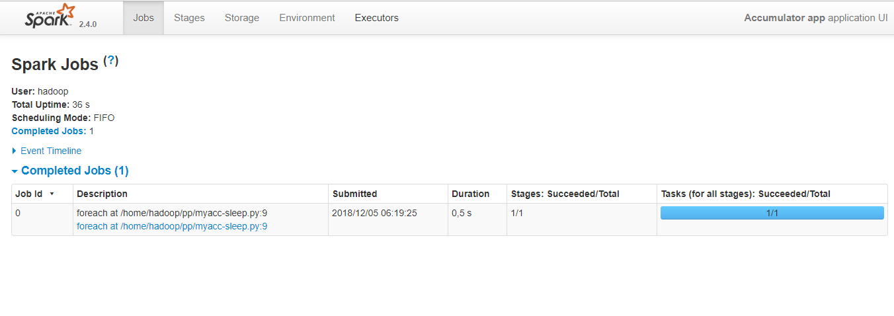
The Web UI @ 4040

Slide 25
# return elements that meet the condition inside f
def f(x): print(x)
rdd2 = rdd.foreach(f)
#filter
filtered = items.filter(lambda x: 'Tadeusz' in x)
filtered = filtered.collect()
#map
words_map = words.map(lambda x: (x, 1))
mapping = words_map.collect()
#reduce
>>> from operator import add
>>> mysum = rdd1.reduce(add)
>>> mysum
21
Example transformations

Slide 26
# to split data between partitions
sc.parallelize(data, 10)
# also textFile has similar argument
textFile(name, minPartitions=None, use_unicode=True)[source]
# inspecting partitions in an RDD
>>> print("Number of partitions: {}".format(rdd1.getNumPartitions()))
Number of partitions: 2
>>> print("Partitioner: {}".format(rdd1.partitioner))
Partitioner: None
>>> print("Partitions structure: {}".format(rdd1.glom().collect()))
Partitions structure: [[1, 2, 3], [4, 5, 6]]
>
#dataframe - can do the same
# need to convert to rdd first though
myDataFrame.rdd.getNumPartitions()
#coalesce() and repartition() transformations are used
# for changing the number of partitions in the RDD.
Understanding partitions

Slide 27
The DAG Scheduler
Divides operators into stages of tasks. A stage is comprised of tasks based on partitions of the input data. The DAG scheduler pipelines operators together. For e.g. Many map operators can be scheduled in a single stage. The final result of a DAG scheduler is a set of stages.
Stages are passed on to the Task Scheduler. The task scheduler launches tasks via cluster manager (Spark Standalone/Yarn/Mesos). The Worker executes the tasks on the Slave.
Transformations are:.
narrow transformation - doesn't require shuffling. Map, filter etc..
wide transformation - requires shuffing, e.g. reduceByKey etc..

Slide 28
hadoop@ubuntu:~/pp$ more wc2.py
from pyspark import SparkContext
sc = SparkContext("local", "word count")
counts = sc.textFile("tadeusz.txt")
.flatMap(lambda line: line.split(" "))
.map(lambda word: (word, 1))
.reduceByKey(lambda a, b: a + b)
counts.saveAsTextFile("ts.txt")
hadoop@ubuntu:~/pp$ spark-submit wc2.py
hadoop@ubuntu:~/pp$ hdfs dfs -cat ts.txt/part-00000|more
(u'', 1126)
(u'konary', 1)
(u'mo\u017cna', 2)
(u'miejsce,', 1)
(u'jelenie', 1)
(u'kr\xf3tki,', 1)
(u'sto\u0142em', 3)
...
Understanding DAG
Shuffling = end of stage

Slide 29
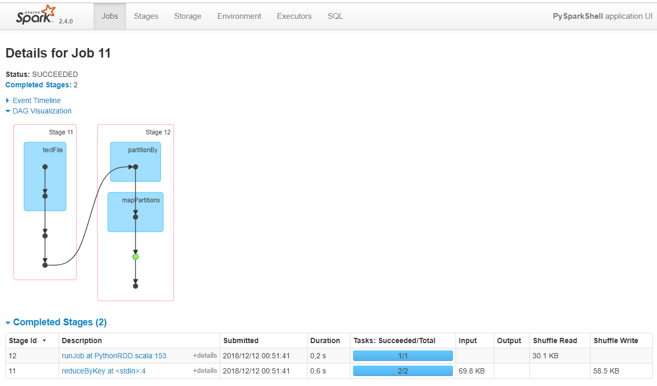

Slide 30
Where to go from here
Pyspark reference, start with RDD, DataFrame and SparkContext, and SparkSession: https://spark.apache.org/docs/latest/api/python/pyspark.html
Online examples: pi,wordcount, and ML: https://spark.apache.org/examples.html
Local examples: spark-submit examples/src/main/python/pi.py
Many more examples in Github: https://github.com/apache/spark/tree/master/examples/src/main/python

